Slide 1
CISC and RISC Processors

Slide 2
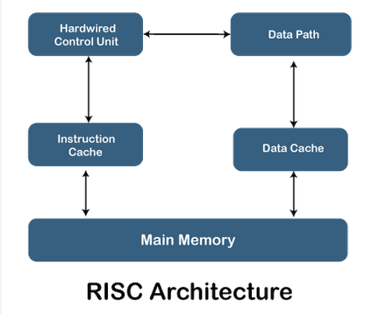
https://www.javatpoint.com/risc-vs-cisc

Slide 3
RISC processor
RISC stands for Reduced Instruction Set Computer Processor,
A microprocessor architecture with a simple collection and highly customized set of instructions.
It is built to minimize the instruction execution time by optimizing and limiting the number of instructions. It means each instruction cycle requires only one clock cycle,
And each cycle contains three parameters: fetch, decode and execute. .

Slide 4
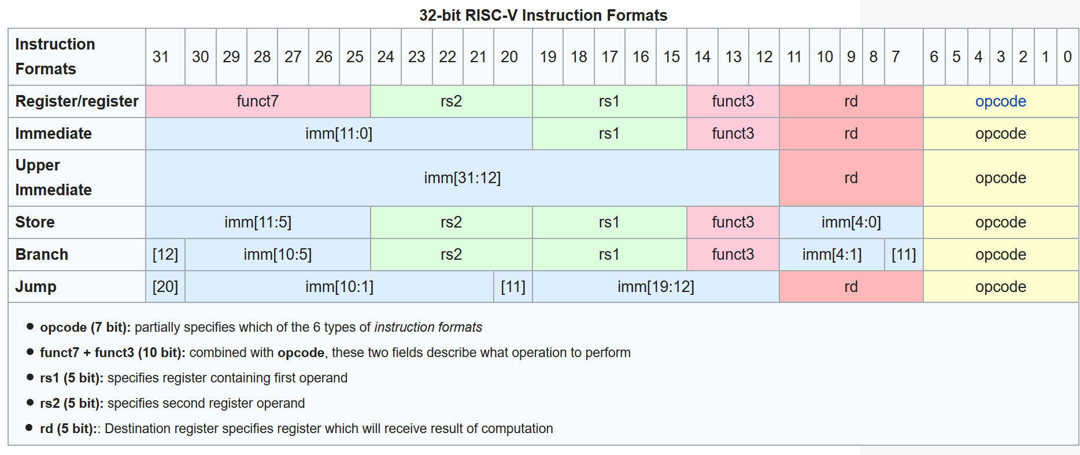

Slide 5
RISC processor
Advantages of RISC Processor
The RISC processor's performance is better due to the simple and limited number of the instruction set.
It requires several transistors that make it cheaper to design.
RISC allows the instruction to use free space on a microprocessor because of its simplicity.
RISC processor is simpler than a CISC processor because of its simple and quick design, and it can complete its work in one clock cycle.

Slide 6
RISC processor
Disadvantages of RISC Processor
The RISC processor's performance may vary according to the code executed because subsequent instructions may depend on the previous instruction for their execution in a cycle.
Programmers and compilers often use complex instructions.
RISC processors require very fast memory to save various instructions that require a large collection of cache memory to respond to the instruction in a short time.

Slide 7
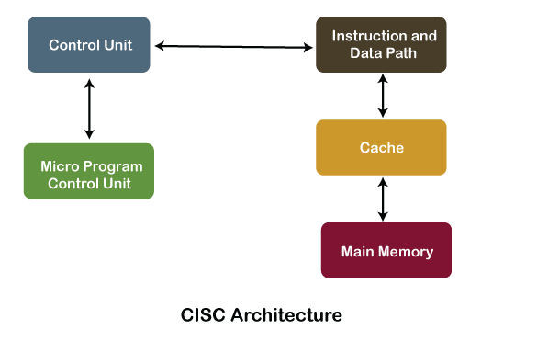
https://www.javatpoint.com/risc-vs-cisc

Slide 8
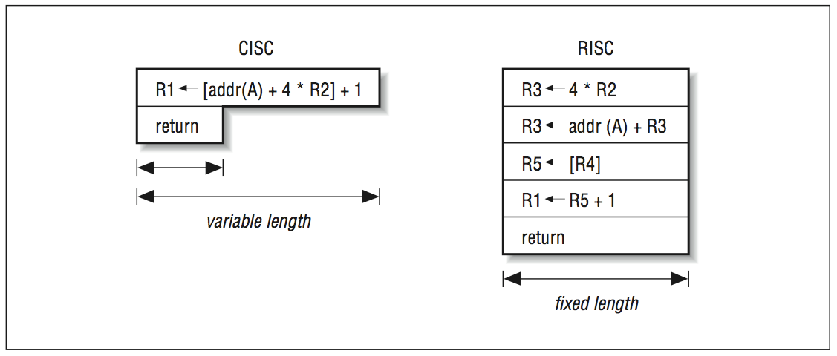

Slide 9
CISC processor
Advantages of CISC Processors
The compiler requires little effort to translate high-level programs or statement languages into assembly or machine language in CISC processors.
The code length is quite short, which minimizes the memory requirement.
To store the instruction on each CISC, it requires very less RAM.
Execution of a single instruction requires several low-level tasks.
CISC creates a process to manage power usage that adjusts clock speed and voltage.
It uses fewer instructions set to perform the same instruction as the RISC.

Slide 10
CISC processor
.
Disadvantages of CISC Processors
CISC chips are slower than RSIC chips to execute per instruction cycle on each program.
The performance of the machine decreases due to the slowness of the clock speed.
Executing the pipeline in the CISC processor makes it complicated to use.
The CISC chips require more transistors as compared to RISC design.
In CISC it uses only 20% of existing instructions in a programming event.

